Slide 1
Chapter 5
Gases
Notes:
1

Slide 2
Introduction
There are three states of matters
Solids
Liquids and
Gases
Notes:
2

Slide 3
Gases
Of the three phases gases are the best understood
There is a minimum of complicating interactions
Gases completely fill whatever space they occupy
In so doing they exert a pressure
Notes:
3

Slide 4
Composition of Air
78.08 % N₂
20.95 % O₂
0.93 % Ar
(up to 4% H₂O)
Notes:
4

Slide 5
Liquid N₂
Here’s a common gas in an uncommon state
N₂(liquid) -196 ºC or -321 ºF
Notes:
5

Slide 6
Kinetic Molecular Theory
Notes:
6

Slide 7
Kinetic Molecular Theory
Most gases behave almost perfectly with respect to a set of six statements known as the kinetic molecular theory
These are found on gas chapter of the text
Gases that adhere to these statements are called ideal gases
Notes:
7

Slide 8
Kinetic Molecular Theory
1. Gases consist of atoms/molecules moving ..along straight lines in random directions ..and various speeds
2. Average kinetic energy is proportional to ..temperature on the kelvin scale
3. Atoms/molecules collide elastically -- no ..energy is lost, it’s just redistributed
Notes:
8

Slide 9
Kinetic Molecular Theory
4. Atoms/molecules are tiny compared to ..distances between them -- gases are mostly ..empty space
5. Atoms/molecules don’t stick when they ..collide; there are no attractive forces
6. Collisions with the wall give rise to the ..pressure measured
Notes:
9

Slide 10
Gas Pressure
Lots of ways to express pressure
1 atmosphere is the average pressure measured at sea level at a temperature of 0ºC
These conditions used to be known as STP, standard temperature and pressure.
(Currently STP is 1 bar and 0ºC)
The average pressure on top of Mt. Everest is 0.349 atm
Notes:
10

Slide 11
Gas Pressure
1 atmosphere = 760 mm Hg
= 760 torr
= 29.92 inches Hg
= 14.7 psi (lbs/in²)
= 1.013 bar
= 1013 mbar
= 101,325 Pa (pascals)
We can use these as conversion factors
Notes:
11

Slide 12
Usually 680 mm Hg in Missoula
Notes:
12

Slide 13
Usually 680 mm Hg in Missoula
680 mm Hg x
Notes:
13

Slide 14
Usually 680 mm Hg in Missoula
760 torr
680 mm Hg x
760 mm Hg
Notes:
14

Slide 15
Usually 680 mm Hg in Missoula
760 torr
680 mm Hg x
= 680 torr
760 mm Hg
Notes:
15

Slide 16
Usually 680 mm Hg in Missoula
760 torr
680 mm Hg x
= 680 torr
760 mm Hg
1 atm
680 mm Hg x
760 mm Hg
Notes:
16

Slide 17
Usually 680 mm Hg in Missoula
760 torr
680 mm Hg x
= 680 torr
760 mm Hg
1 atm
680 mm Hg x
= 0.895 atm
760 mm Hg
Notes:
17

Slide 18
Usually 680 mm Hg in Missoula
760 torr
680 mm Hg x
= 680 torr
760 mm Hg
1 atm
680 mm Hg x
= 0.895 atm
760 mm Hg
29.92 in Hg
680 mm Hg x
760 mm Hg
Notes:
18

Slide 19
Usually 680 mm Hg in Missoula
760 torr
680 mm Hg x
= 680 torr
760 mm Hg
1 atm
680 mm Hg x
= 0.895 atm
760 mm Hg
29.92 in Hg
680 mm Hg x
= 26.77 in Hg
760 mm Hg
Notes:
19

Slide 20
During fall 2005, a hurricane hunter plane, flying through the eye of Hurricane Wilma, measured an Atlantic Ocean record low pressure of 882 millibars. What is this in atmospheres?
0.871 atm
0.882 atm
0.862 atm
0.894 atm
Notes:
20

Slide 21
Gas Laws
Four “constants” with ideal gases
Boyle’s Law: PV = a constant. ..(1662)
Charles’s Law: V/T = a constant. ..(1787)
Gay-Lussac’s Law: P/T = a constant ..(1802)
Avogadro’s Law: V/n = a constant. ..(1811)
Notes:
21

Slide 22
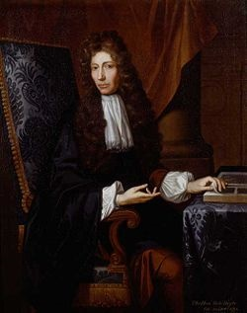
Pressure-Volume relationship: Boyles Law
Robert Boyle (1627 – 1691). British chemist and natural philosopher. Wrote the book “The Skeptical Chymist (1661)” influenced generation of chemists.

Slide 23
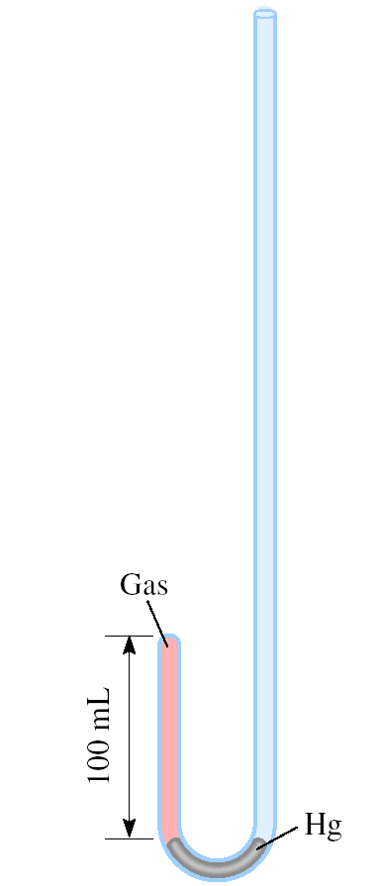
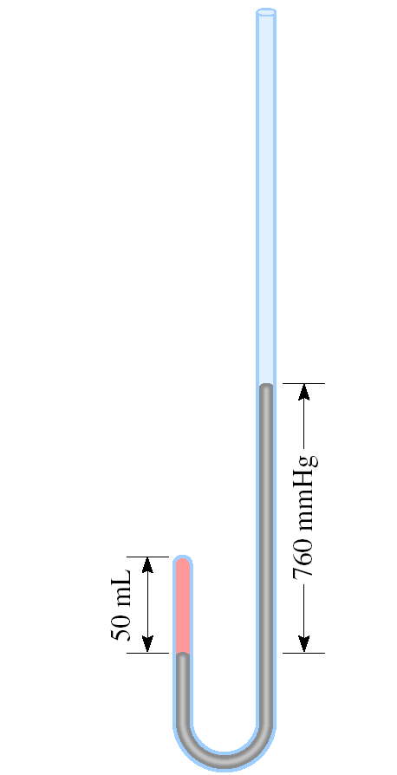
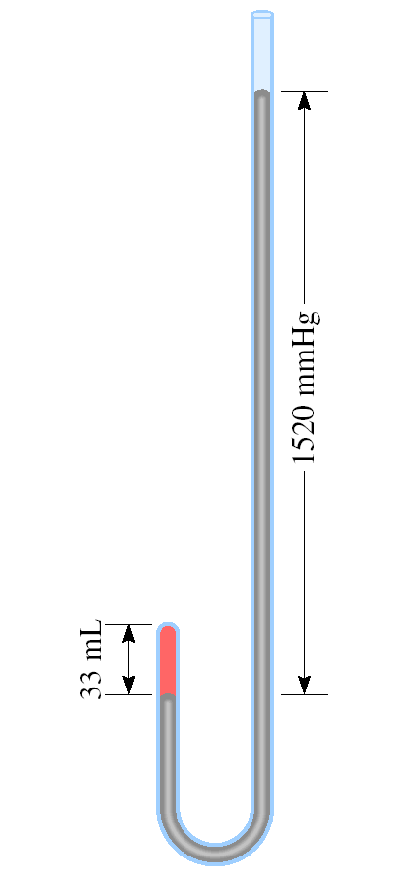
Apparatus for Studying the Relationship Between
Pressure and Volume of a Gas
As P (h) increases
V decreases

Slide 24
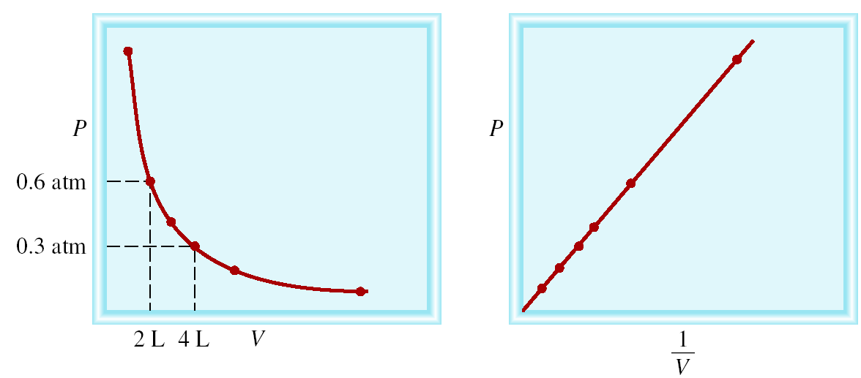
Boyle’s Law
P α 1/V
Constant temperature Constant amount of gas
P x V = constant
P₁ x V₁ = P₂ x V₂

Slide 25
A sample of chlorine gas occupies a volume of 946 mL at a pressure of 726 mmHg. What is the pressure of the gas (in mmHg) if the volume is reduced at constant temperature to 154 mL?
P x V = constant
P₁ x V₁ = P₂ x V₂
P₁ = 726 mmHg
P₂ = ?
V₁ = 946 mL
V₂ = 154 mL
P₁ x V₁
726 mmHg x 946 mL
P₂ =
=
= 4460 mmHg
V₂
154 mL

Slide 26
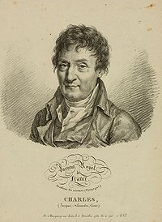
Temperature-Volume Relationship: Charles's and Gay-Lussac’s Law
Jacques Alexandre Cesar Charles (1746 – 1823). French physicist. He was a gifted lecturer, an inventor of scientific apparatus and the first person to use hydrogen to inflate balloons.

Slide 27
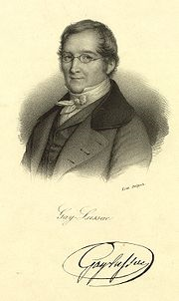
Temperature-Volume Relationship: Charle’s and Gay-Lussac’s Law
Joseph Louis Gay-Lussac (1778 – 1850). French chemist and physicist. He was a balloon enthusiast. Once he ascended to an altitude of 20,000 ft to collect air samples for analysis.

Slide 28
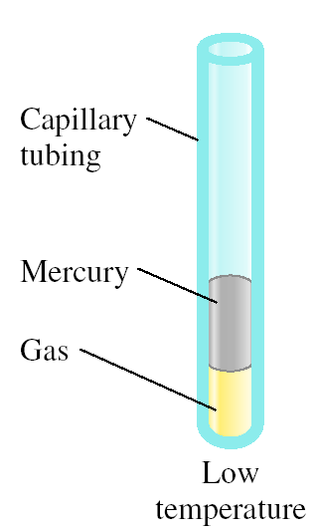
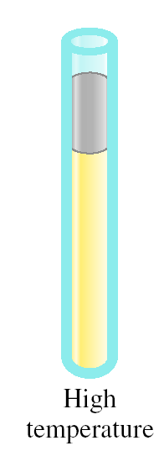
Variation in Gas Volume
with Temperature at Constant Pressure
As T increases
V increases

Slide 29
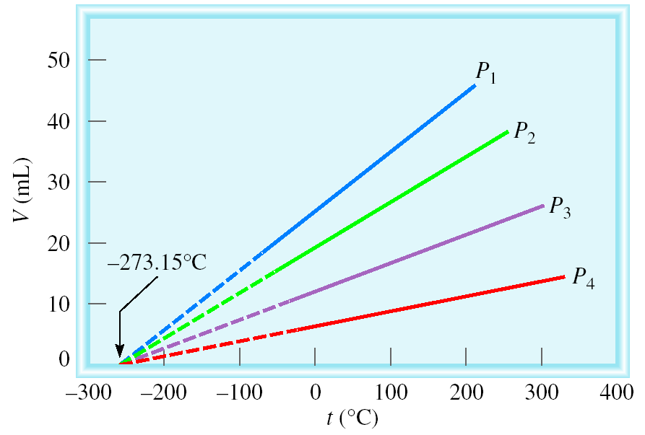
Variation of Gas Volume with Temperature
at Constant Pressure
Charles’ & Gay-Lussac’s Law
V α T
Temperature must be in Kelvin
V = constant x T
V₁/T₁ = V₂ /T₂
T (K) = t (⁰C) + 273.15

Slide 30
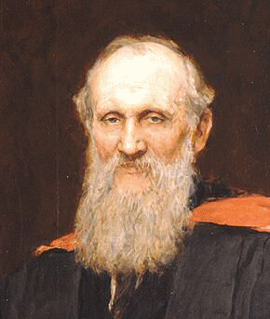
Kelvin Temperature Scale
William Thomson, Lord Kelvin (1824 – 1907). Scottish mathematician and physicist. Kelvin did important work in many branches of physics.

Slide 31
A sample of carbon monoxide gas occupies 3.20 L at 125 ⁰C. At what temperature will the gas occupy a volume of 1.54 L if the pressure remains constant?
V₁ /T₁ = V₂ /T₂
V₁ = 3.20 L
V₂ = 1.54 L
T₁ = 398.15 K
T₂ = ?
T₁ = 125 (⁰C) + 273.15 (K) = 398.15 K
V₂ x T₁
1.54 L x 398.15 K
T₂ =
=
= 192 K
V₁
3.20 L

Slide 32
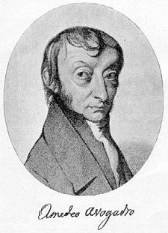
Volume-Amount Relationship: Avogadro’s Law
Amedeo Avogadro (1776 – 1856). Italian mathematical physicist. His most famous work, now known as Avogadro’s law, was largely ignored his lifetime.

Slide 33
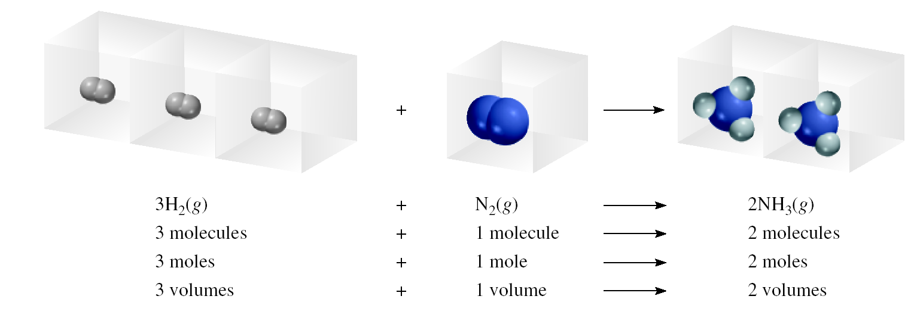
Avogadro’s Law
V α number of moles (n)
Constant temperature Constant pressure
V = constant x n
V₁ / n₁ = V₂ / n₂

Slide 34
Ammonia burns in oxygen to form nitric oxide (NO) and water vapor. How many volumes of NO are obtained from one volume of ammonia at the same temperature and pressure?
4NH₃ + 5O₂ 4NO + 6H₂O
1 mole NH₃ 1 mole NO
At constant T and P
1 volume NH₃ 1 volume NO

Slide 35
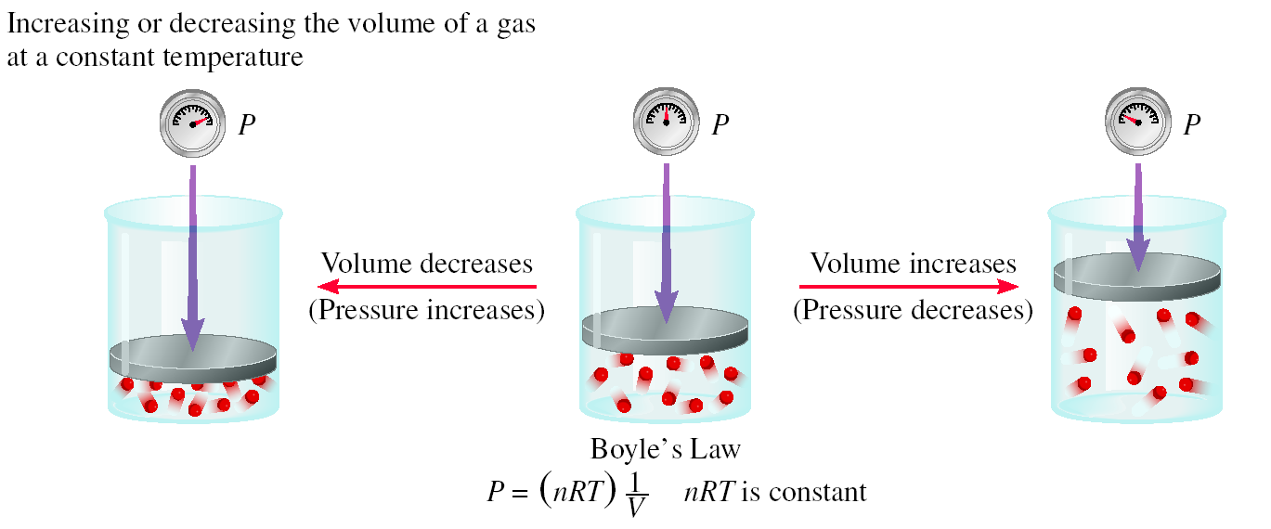
Summary of Gas Laws
Boyle’s Law

Slide 36
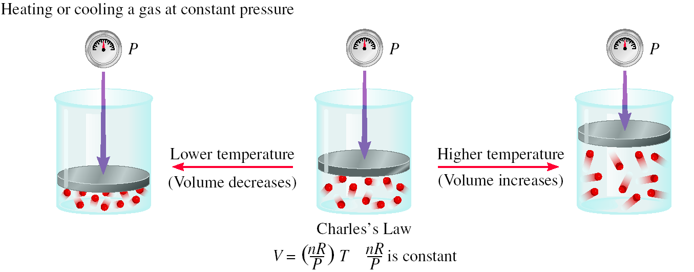
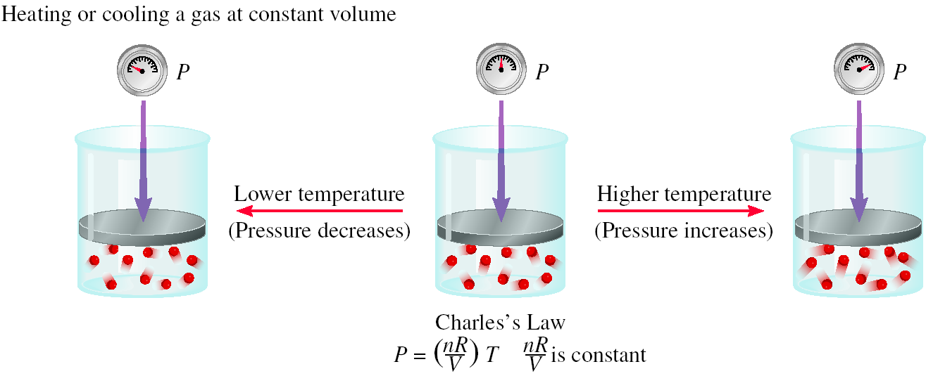
Charles Law

Slide 37
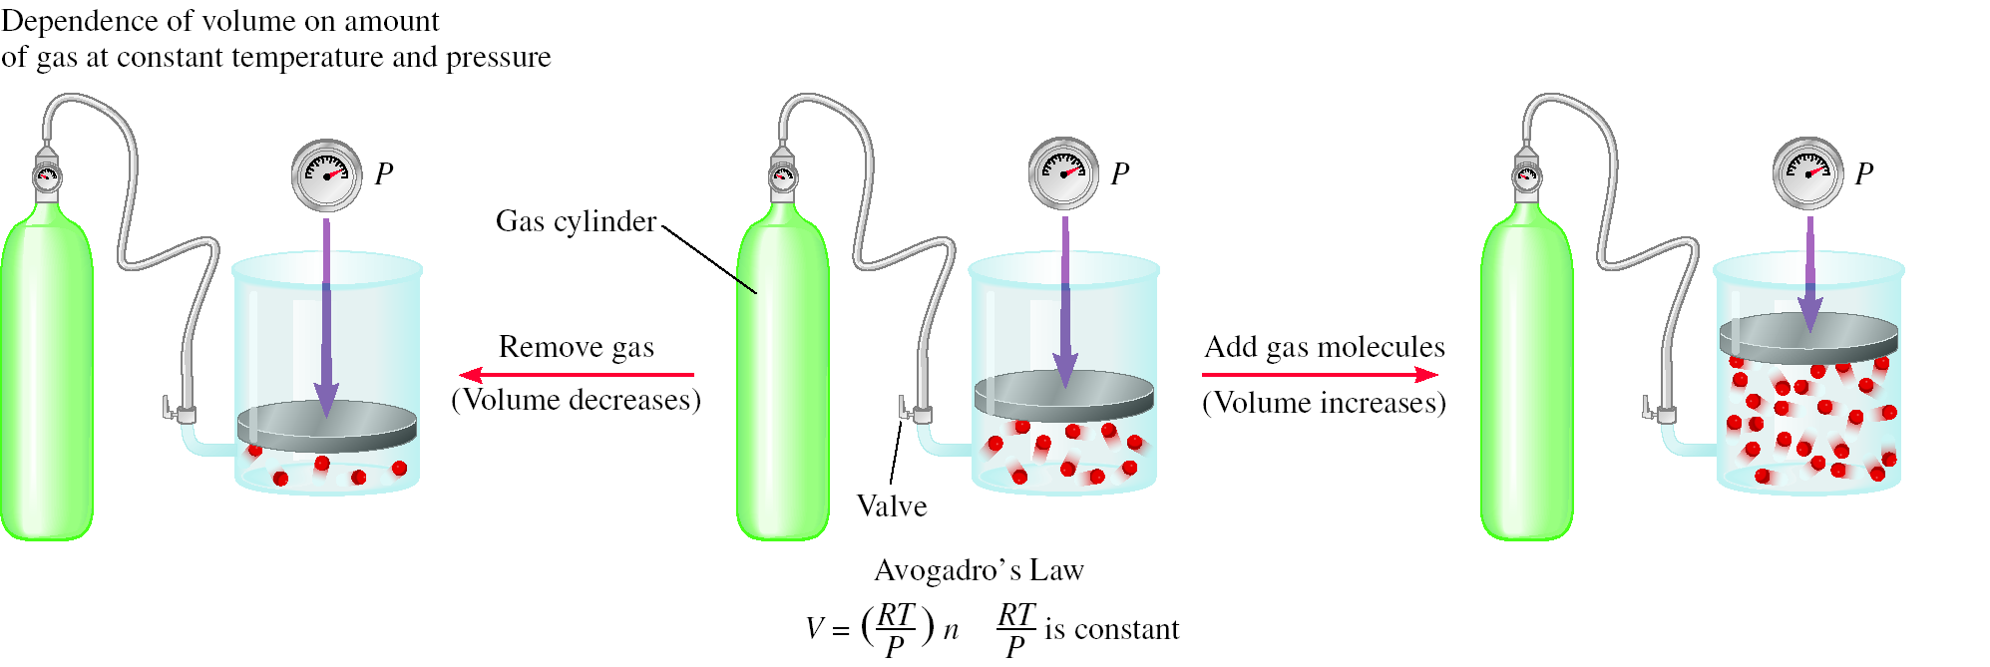
Avogadro’s Law

Slide 38
Ideal Gas Law
The four individual “constants” can be gathered into a overall combination “constant”
Notes:
38

Slide 39
Ideal Gas Law
The four individual “constants” can be gathered into a overall combination “constant”
PV
= a constant
nT
Notes:
39

Slide 40
Ideal Gas Law
The four individual “constants” can be gathered into a overall combination “constant”
PV
= a constant = R
nT
Notes:
40

Slide 41
Ideal Gas Law
The four individual “constants” can be gathered into a overall combination “constant”
PV
= a constant = R
nT
or PV = nRT
Notes:
41

Slide 42
Ideal Gas Law
All gas law calculations can be boiled down to the ideal gas law expression
PV = nRT
P - pressure in atm or torr
V - volume in liters
n - number of moles
T - temperature in kelvin
Notes:
42

Slide 43
Universal Gas Constant, R
Depends on units employed for the four variables
Notes:
43

Slide 44
Universal Gas Constant, R
Depends on units employed for the four variables
L atm
R = 0.0821
mol K
Notes:
44

Slide 45
Universal Gas Constant, R
Depends on units employed for the four variables
L atm
R = 0.0821
mol K
L torr
R = 62.4
mol K
Notes:
45

Slide 46
Universal Gas Constant, R
Depends on units employed for the four variables
L atm
R = 0.0821
mol K
L torr
R = 62.4
mol K
0.0821 x 760 = 62.4
Notes:
46

Slide 47
Which weighs most – dry air or moist air?
Avogadro’s hypothesis helps explain in part how hurricanes work
His hypothesis was: Equal volumes of gas at the same temperature and pressure contain equal numbers of molecules
Using this thought, answer this question: Which weighs most – dry air or moist air?

Slide 48
N₂ 28 amu
O₂ 32 amu
Dry air

Slide 49
N₂ 28 amu
O₂ 32 amu
H₂O 18 amu
Dry air
Moist air

Slide 50
N₂ 28 amu
O₂ 32 amu
H₂O 18 amu
Dry air
Moist air
The lighter water molecules make moist air about 2% lighter

Slide 51
Isolating variables
Knowing the values of any three variables allows one to solve for the fourth.
Consider how you’d calculate an unknown pressure.
You’d isolate the variable P…
PV
= R
nT
Notes:
51

Slide 52
Isolating variables
Knowing the values of any three variables allows one to solve for the fourth.
Consider how you’d calculate an unknown pressure.
You’d isolate the variable P…
PV
x nT
nT x
= R
nT
Notes:
52

Slide 53
Isolating variables
Knowing the values of any three variables allows one to solve for the fourth.
Consider how you’d calculate an unknown pressure.
You’d isolate the variable P…
PV
x nT
nT x
= R
nT
Notes:
53

Slide 54
Isolating variables
Knowing the values of any three variables allows one to solve for the fourth.
Consider how you’d calculate an unknown pressure.
You’d isolate the variable P…
PV
= nRT
Notes:
54

Slide 55
Isolating variables
Knowing the values of any three variables allows one to solve for the fourth.
Consider how you’d calculate an unknown pressure.
You’d isolate the variable P…
PV
= nRT
V
V
Notes:
55

Slide 56
Isolating variables
Knowing the values of any three variables allows one to solve for the fourth.
Consider how you’d calculate an unknown pressure.
You’d isolate the variable P…
nRT
P =
V
Notes:
56

Slide 57
1-State Problems
Knowing the values of any three variables allows one to solve for the fourth...
nRT
P =
V
Notes:
57

Slide 58
If PV = nRT, what does V =?
nRTP
nRT/P
P/nRT
nRT-P
Notes:
58

Slide 59
If PV = nRT, what does V =?
nRTP
nRT/P
P/nRT
nRT-P
Notes:
59

Slide 60
1-State Problems
Knowing the values of any three variables allows one to solve for the fourth...
nRT
nRT
P =
V =
V
P
Notes:
60

Slide 61
1-State Problems
Knowing the values of any three variables allows one to solve for the fourth...
nRT
nRT
P =
V =
V
P
PV
n =
RT
Notes:
61

Slide 62
If PV = nRT, what does T =?
nR/PV
PVn/R
PVR/n
PV/nR
Notes:
62

Slide 63
If PV = nRT, what does T =?
nR/PV
PVn/R
PVR/n
PV/nR
Notes:
63

Slide 64
1-State Problems
Knowing the values of any three variables allows one to solve for the fourth...
nRT
nRT
P =
V =
V
P
PV
PV
n =
T =
RT
nR
Notes:
64

Slide 65
Sample 1-State Problem
How many moles of air are in the lungs of an average woman with a vital lung capacity of 3.6 L? Assume sea level and a body temperature of 37 ºC.
Notes:
65

Slide 66
Sample 1-State Problem
How many moles of air are in the lungs of an average woman with a vital lung capacity of 3.6 L? Assume sea level and a body temperature of 37 ºC.
Problem asks for moles, so use “n =“ form of the ideal gas law
Notes:
66

Slide 67
Sample 1-State Problem
How many moles of air are in the lungs of an average woman with a vital lung capacity of 3.6 L? Assume sea level and a body temperature of 37 ºC.
PV
n =
RT
Notes:
67

Slide 68
Sample 1-State Problem
How many moles of air are in the lungs of an average woman with a vital lung capacity of 3.6 L? Assume sea level and a body temperature of 37 ºC.
PV
(1 atm)V
n =
=
RT
RT
Notes:
68

Slide 69
Sample 1-State Problem
How many moles of air are in the lungs of an average woman with a vital lung capacity of 3.6 L? Assume sea level and a body temperature of 37 ºC.
PV
(1 atm)(3.6 L)
n =
=
RT
RT
Notes:
69

Slide 70
Sample 1-State Problem
How many moles of air are in the lungs of an average woman with a vital lung capacity of 3.6 L? Assume sea level and a body temperature of 37 ºC.
PV
(1 atm)(3.6 L)
n =
=
RT
R(310 K)
K = 37 ºC + 273 = 310 K
Notes:
70

Slide 71
Sample 1-State Problem
How many moles of air are in the lungs of an average woman with a vital lung capacity of 3.6 L? Assume sea level and a body temperature of 37 ºC.
PV
(1 atm)(3.6 L)
n =
=
RT
R(310 K)
Pressure in atm so use 0.0821 for R
Notes:
71

Slide 72
Sample 1-State Problem
How many moles of air are in the lungs of an average woman with a vital lung capacity of 3.6 L? Assume sea level and a body temperature of 37 ºC.
PV
(1 atm)(3.6 L)
n =
=
RT
(0.0821 ) (310 K)
L atm
mol K
Pressure in atm so use 0.0821 for R
Notes:
72

Slide 73
Sample 1-State Problem
How many moles of air are in the lungs of an average woman with a vital lung capacity of 3.6 L? Assume sea level and a body temperature of 37 ºC.
PV
(1 atm)(3.6 L)
n =
=
RT
(0.0821 ) (310 K)
L atm
mol K
Notes:
73

Slide 74
Sample 1-State Problem
How many moles of air are in the lungs of an average woman with a vital lung capacity of 3.6 L? Assume sea level and a body temperature of 37 ºC.
PV
(1 atm)(3.6 L)
n =
=
RT
(0.0821 ) (310 K)
L atm
mol K
= 0.14 mol
Notes:
74

Slide 75
2-State Problems
These are “before” and “after” problems
A sample of gas undergoes a change
Not all variables may be affected
You need to find the value of the unknown variable in one of the states
(usually it’s in the “after” state)
Notes:
75

Slide 76
2-State Problems
Set these up by writing the ideal gas law two times
Once for each state
Use subscripts to indicate the “before” and “after” states
Notes:
76

Slide 77
2-State Problems
Set these up by writing the ideal gas law two times
Once for each state
Use subscripts to indicate the “before” and “after” states
P₂V₂ = n₂RT₂ (after state)
Notes:
77

Slide 78
2-State Problems
Set these up by writing the ideal gas law two times
Once for each state
Use subscripts to indicate the “before” and “after” states
P₂V₂ = n₂RT₂ (after state)
P₁V₁ = n₁RT₁ (before state)
Notes:
78

Slide 79
2-State Problems
Now, ratio the two equations
P₂V₂ = n₂RT₂ (after state)
P₁V₁ = n₁RT₁ (before state)
Notes:
79

Slide 80
2-State Problems
Now, ratio the two equations
P₂V₂ = n₂RT₂ (after state)
=
P₁V₁ = n₁RT₁ (before state)
Notes:
80

Slide 81
2-State Problems
Now, ratio the two equations
And cancel the R’s
P₂V₂ = n₂RT₂ (after state)
=
P₁V₁ = n₁RT₁ (before state)
Notes:
81

Slide 82
2-State Problems
Now, ratio the two equations
And cancel the R’s
P₂V₂ = n₂RT₂ (after state)
=
P₁V₁ = n₁RT₁ (before state)
Notes:
82

Slide 83
2-State Problems
Now, ratio the two equations
And cancel the R’s
P₂V₂ = n₂T₂ (after state)
=
P₁V₁ = n₁T₁ (before state)
Notes:
83

Slide 84
Sample 2-State Problem
A balloon is partially filled with helium at 27º C and 740 torr. It’s initial volume is 10 m³. What volume would it have at higher altitude where the pressure is 370 torr and the temperature is -23 ºC?
P₂V₂ = n₂T₂ (after state)
=
P₁V₁ = n₁T₁ (before state)
Notes:
84

Slide 85
Sample 2-State Problem
A balloon is partially filled with helium at 27º C and 740 torr. It’s initial volume is 10 m³. What volume would it have at higher altitude where the pressure is 370 torr and the temperature is -23 ºC?
P₂V₂ = n₂T₂ (after state)
=
P₁V₁ = n₁T₁ (before state)
If you see two of anything it’s a 2-state problem!
Notes:
85

Slide 86
Sample 2-State Problem
A balloon is partially filled with helium at 27º C and 740 torr. It’s initial volume is 10 m³. What volume would it have at higher altitude where the pressure is 370 torr and the temperature is -23 ºC?
P₂V₂ = n₂T₂ (after state)
=
P₁V₁ = n₁T₁ (before state)
Two temperatures!
Notes:
86

Slide 87
Sample 2-State Problem
A balloon is partially filled with helium at 27º C and 740 torr. It’s initial volume is 10 m³. What volume would it have at higher altitude where the pressure is 370 torr and the temperature is -23 ºC?
P₂V₂ = n₂T₂ (after state)
=
P₁V₁ = n₁T₁ (before state)
Here’s our unknown variable
Notes:
87

Slide 88
Sample 2-State Problem
A balloon is partially filled with helium at 27º C and 740 torr. It’s initial volume is 10 m³. What volume would it have at higher altitude where the pressure is 370 torr and the temperature is -23 ºC?
P₂V₂ = n₂T₂ (after state)
=
P₁V₁ = n₁T₁ (before state)
Here’s our unknown variable
Notes:
88

Slide 89
Sample 2-State Problem
A balloon is partially filled with helium at 27º C and 740 torr. It’s initial volume is 10 m³. What volume would it have at higher altitude where the pressure is 370 torr and the temperature is -23 ºC?
P₂V₂ = n₂T₂ (after state)
=
P₁V₁ = n₁T₁ (before state)
Start substituting in the variables provided
Notes:
89

Slide 90
Sample 2-State Problem
A balloon is partially filled with helium at 27º C and 740 torr. It’s initial volume is 10 m³. What volume would it have at higher altitude where the pressure is 370 torr and the temperature is -23 ºC?
P₂V₂ = n₂T₂ (after state)
=
(740 torr)V₁ = n₁T₁ (before state)
Start substituting in the variables provided
Notes:
90

Slide 91
Sample 2-State Problem
A balloon is partially filled with helium at 27º C and 740 torr. It’s initial volume is 10 m³. What volume would it have at higher altitude where the pressure is 370 torr and the temperature is -23 ºC?
(370 torr)V₂ = n₂T₂ (after state)
=
(740 torr)V₁ = n₁T₁ (before state)
Start substituting in the variables provided
Notes:
91

Slide 92
Sample 2-State Problem
A balloon is partially filled with helium at 27º C and 740 torr. It’s initial volume is 10 m³. What volume would it have at higher altitude where the pressure is 370 torr and the temperature is -23 ºC?
(370 torr) V₂ n₂T₂ (after)
=
(740 torr)(10 m³) = n₁T₁ (before)
Start substituting in the variables provided
Notes:
92

Slide 93
Sample 2-State Problem
A balloon is partially filled with helium at 27º C and 740 torr. It’s initial volume is 10 m³. What volume would it have at higher altitude where the pressure is 370 torr and the temperature is -23 ºC?
(370 torr) V₂ n₂T₂ (after)
=
(740 torr)(10 m³) = n₁T₁ (before)
T₁ = 27 ºC + 273 = 300 K
Notes:
93

Slide 94
Sample 2-State Problem
A balloon is partially filled with helium at 27º C and 740 torr. It’s initial volume is 10 m³. What volume would it have at higher altitude where the pressure is 370 torr and the temperature is -23 ºC?
(370 torr) V₂ n₂T₂ (after)
=
(740 torr)(10 m³) = n₁(300 K)
T₁ = 27 ºC + 273 = 300 K
Notes:
94

Slide 95
Sample 2-State Problem
A balloon is partially filled with helium at 27º C and 740 torr. It’s initial volume is 10 m³. What volume would it have at higher altitude where the pressure is 370 torr and the temperature is -23 ºC?
(370 torr) V₂ n₂T₂ (after)
=
(740 torr)(10 m³) = n₁(300 K)
T₂ = -23 ºC + 273 = 250 K
Notes:
95

Slide 96
Sample 2-State Problem
A balloon is partially filled with helium at 27º C and 740 torr. It’s initial volume is 10 m³. What volume would it have at higher altitude where the pressure is 370 torr and the temperature is -23 ºC?
(370 torr) V₂ n₂ (250 K)
=
(740 torr)(10 m³) = n₁(300 K)
T₂ = -23 ºC + 273 = 250 K
Notes:
96

Slide 97
Sample 2-State Problem
A balloon is partially filled with helium at 27º C and 740 torr. It’s initial volume is 10 m³. What volume would it have at higher altitude where the pressure is 370 torr and the temperature is -23 ºC?
(370 torr) V₂ n₂ (250 K)
=
(740 torr)(10 m³) = n₁(300 K)
n₁ = n₂ (closed system), so they cancel
Notes:
97

Slide 98
Sample 2-State Problem
A balloon is partially filled with helium at 27º C and 740 torr. It’s initial volume is 10 m³. What volume would it have at higher altitude where the pressure is 370 torr and the temperature is -23 ºC?
(370 torr) V₂ (250 K)
=
(740 torr)(10 m³) = (300 K)
Notes:
98

Slide 99
Sample 2-State Problem
Now do the math...
(370 torr) V₂ (250 K)
=
(740 torr)(10 m³) = (300 K)
Notes:
99

Slide 100
Sample 2-State Problem
Now do the math...
(370 torr) V₂ (250 K)
=
(740 torr)(10 m³) = (300 K)
Isolate your unknown by moving values to the other side of the equation…
Notes:
100

Slide 101
Sample 2-State Problem
Now do the math...
(370 torr) V₂ (250 K)
=
(740 torr)(10 m³) = (300 K)
Isolate your unknown by moving values to the other side of the equation…
remembering to “flip over” as you “ship over”
Notes:
101

Slide 102
Sample 2-State Problem
Now do the math...
(370 torr) V₂ (250 K)
=
(740 torr)(10 m³) = (300 K) (370 torr)
Isolate your unknown by moving values to the other side of the equation…
remembering to “flip over” as you “ship over”
Notes:
102

Slide 103
Sample 2-State Problem
Now do the math...
(370 torr) V₂ (250 K) (740 torr)
=
(740 torr)(10 m³) = (300 K) (370 torr)
Isolate your unknown by moving values to the other side of the equation…
remembering to “flip over” as you “ship over”
Notes:
103

Slide 104
Sample 2-State Problem
Now do the math...
( V₂ (250 K) (740 torr) (10 m³)
V₂
=
(10 m³) = (300 K) (370 torr)
Isolate your unknown by moving values to the other side of the equation…
remembering to “flip over” as you “ship over”
Notes:
104

Slide 105
Sample 2-State Problem
Now do the math...
( V₂ (250 K) (740 torr) (10 m³)
V₂
=
(10 m³) = (300 K) (370 torr)
Isolate your unknown by moving values to the other side of the equation…
remembering to “flip over” as you “ship over”
Notes:
105

Slide 106
Sample 2-State Problem
Now do the math...
( V₂ (250 K) (740 torr) (10 m³)
V₂
=
(10 m³) = (300 K) (370 torr)
= 17 m³
Notes:
106

Slide 107
Mass/Formula Weight Problems
A third variation of the ideal gas law substitutes mass and formula weight information in place of n

Slide 108
Mass/Formula Weight Problems
A third variation of the ideal gas law substitutes mass and formula weight information in place of n
PV = nRT

Slide 109
Mass/Formula Weight Problems
A third variation of the ideal gas law substitutes mass and formula weight information in place of n
PV = nRT
m(g)
but n (mol) =
f.w.(g/mol)

Slide 110
Mass/Formula Weight Problems
A third variation of the ideal gas law substitutes mass and formula weight information in place of n
mRT
PV =
f.w.

Slide 111
Mass/Formula Weight Problem
If 5.0 grams of CO₂ gas are placed in a 10-L vessel at 350 K, what is the pressure?
mRT
PV =
f.w.

Slide 112
Mass/Formula Weight Problem
If 5.0 grams of CO₂ gas are placed in a 10-L vessel at 350 K, what is the pressure?
(5.0 g)RT
PV =
f.w.

Slide 113
Mass/Formula Weight Problem
If 5.0 grams of CO₂ gas are placed in a 10-L vessel at 350 K, what is the pressure?
(5.0 g)RT
PV =
(44.01 g/mol)
f.w. = (12.01 g) + 2(16.00 g) = 44.01g

Slide 114
Mass/Formula Weight Problem
If 5.0 grams of CO₂ gas are placed in a 10-L vessel at 350 K, what is the pressure?
(5.0 g)RT
P(10 L) =
(44.01 g/mol)

Slide 115
Mass/Formula Weight Problem
If 5.0 grams of CO₂ gas are placed in a 10-L vessel at 350 K, what is the pressure?
(5.0 g)R(350 K)
P(10 L) =
(44.01 g/mol)

Slide 116
Mass/Formula Weight Problem
If 5.0 grams of CO₂ gas are placed in a 10-L vessel at 350 K, what is the pressure?
(5.0 g)R(350 K)
P(10 L) =
(44.01 g/mol)
Pressure determines which R to use, let’s use atmospheres...

Slide 117
Mass/Formula Weight Problem
If 5.0 grams of CO₂ gas are placed in a 10-L vessel at 350 K, what is the pressure?
L atm
(5.0 g)(0.0821 )(350 K)
P(10 L) =
mol K
(44.01 g/mol)
Pressure determines which R to use, let’s use atmospheres...

Slide 118
Mass/Formula Weight Problem
If 5.0 grams of CO₂ gas are placed in a 10-L vessel at 350 K, what is the pressure?
L atm
(5.0 g)(0.0821 )(350 K)
P(10 L) =
mol K
(44.01 g/mol)
Isolate the unknown variable by shipping over the 10 L volume

Slide 119
Mass/Formula Weight Problem
If 5.0 grams of CO₂ gas are placed in a 10-L vessel at 350 K, what is the pressure?
L atm
(5.0 g)(0.0821 )(350 K)
P L) =
mol K
(44.01 g/mol) (10 L)
Isolate the unknown variable by shipping over the 10 L volume

Slide 120
Mass/Formula Weight Problem
If 5.0 grams of CO₂ gas are placed in a 10-L vessel at 350 K, what is the pressure?
L atm
(5.0 g)(0.0821 )(350 K)
P L) =
mol K
(44.01 g/mol) (10 L)
= 0.33 atm

Slide 121
Gas Law Problem Summary
1-State: Knowing the values of any three variables, solve for the fourth (3 variables given)
2-State: A sample of gas undergoes a change; find the value of the unknown variable in one of the states (usually the “after” state) (2 values of same kind)
Mass/f.w.: A 1-state problem where n is replaced by m/f.w. (grams in problem)

Slide 122
What kind of problem is this?
5.39 An 8.00-g sample of a gas occupies 22.4 liters at 2.00 atm and 273K. What is the molecular weight of the gas?
1-state
2-state
Mass/f.w.

Slide 123
What kind of problem is this?
5.39 An 8.00-g sample of a gas occupies 22.4 liters at 2.00 atm and 273K. What is the molecular weight of the gas?
1-state
2-state
Mass/f.w.

Slide 124
What kind of problem is this?
5.39 An 8.00-g sample of a gas occupies 22.4 liters at 2.00 atm and 273K. What is the molecular weight of the gas?
It’s got grams, so it’s a mass/f.w. problem

Slide 125
What kind of problem is this?
5.39 An 8.00-g sample of a gas occupies 22.4 liters at 2.00 atm and 273K. What is the molecular weight of the gas?
mRT
PV =
f.w.

Slide 126
What kind of problem is this?
5.39 An 8.00-g sample of a gas occupies 22.4 liters at 2.00 atm and 273K. What is the molecular weight of the gas?
mRT
PV =
f.w.
(8.00 g)(0.0821 L atm/mol K)(273 K)
(2.00 atm)(22.4 L)
=
f.w.

Slide 127
What kind of problem is this?
5.39 An 8.00-g sample of a gas occupies 22.4 liters at 2.00 atm and 273K. What is the molecular weight of the gas?
mRT
PV =
f.w.
(8.00 g)(0.0821 L atm/mol K)(273 K)
(2.00 atm)(22.4 L)
=
f.w.
(8.00 g)(0.0821 L atm/mol K)(273 K)
f.w.
=
(2.00 atm)(22.4 L)

Slide 128
What kind of problem is this?
5.39 An 8.00-g sample of a gas occupies 22.4 liters at 2.00 atm and 273K. What is the molecular weight of the gas?
mRT
PV =
f.w.
(8.00 g)(0.0821 L atm/mol K)(273 K)
(2.00 atm)(22.4 L)
=
f.w.
(8.00 g)(0.0821 L atm/mol K)(273 K)
f.w.
=
(2.00 atm)(22.4 L)
=
4.00 g/mol (it’s helium!)

Slide 129
What kind of problem is this?
How much volume is occupied by 2.50 moles of O₂ gas at a room temperature of 25ºC and 0.895 atm pressure?
1-state
2-state
Mass/f.w.

Slide 130
What kind of problem is this?
How much volume is occupied by 2.50 moles of O₂ gas at a room temperature of 25ºC and 0.895 atm pressure?
1-state
2-state
Mass/f.w.

Slide 131
What kind of problem is this?
How much volume is occupied by 2.50 moles of O₂ gas at a room temperature of 25ºC and 0.895 atm pressure?
It’s got 3 variables, none doubled, so it’s a 1-state problem

Slide 132
What kind of problem is this?
How much volume is occupied by 2.50 moles of O₂ gas at a room temperature of 25ºC and 0.895 atm pressure?
nRT
V =
P

Slide 133
What kind of problem is this?
How much volume is occupied by 2.50 moles of O₂ gas at a room temperature of 25ºC and 0.895 atm pressure?
nRT
V =
P
(2.50 mol)(0.0821 L atm/mol K)( 298 K)
V =
(0.895 atm)

Slide 134
What kind of problem is this?
How much volume is occupied by 2.50 moles of O₂ gas at a room temperature of 25ºC and 0.895 atm pressure?
nRT
V =
P
(2.50 mol)(0.0821 L atm/mol K)( 298 K)
V =
(0.895 atm)
=
68.3 L

Slide 135
What kind of problem is this?
An autoclave is a heavy steel chamber into which steam is injected. Under 1.00 atm pressure, the steam temperature is 100.0 ºC. What pressure setting is needed to obtain 165ºC for sterilizing surgical instruments?
1-state
2-state
Mass/f.w.

Slide 136
What kind of problem is this?
An autoclave is a heavy steel chamber into which steam is injected. Under 1.00 atm pressure, the steam temperature is 100.0 ºC. What pressure setting is needed to obtain 165ºC for sterilizing surgical instruments?
1-state
2-state
Mass/f.w.

Slide 137
What kind of problem is this?
An autoclave is a heavy steel chamber into which steam is injected. Under 1.00 atm pressure, the steam temperature is 100.0 ºC. What pressure setting is needed to obtain 165ºC for sterilizing surgical instruments?
It’s got 2 temperatures, so it’s a 2-state problem

Slide 138
What kind of problem is this?
An autoclave is a heavy steel chamber into which steam is injected. Under 1.00 atm pressure, the steam temperature is 100.0 ºC. What pressure setting is needed to obtain 165ºC for sterilizing surgical instruments?
P₂V₂
n₂T₂
=
P₁V₁
n₁T₁

Slide 139
What kind of problem is this?
An autoclave is a heavy steel chamber into which steam is injected. Under 1.00 atm pressure, the steam temperature is 100.0 ºC. What pressure setting is needed to obtain 165ºC for sterilizing surgical instruments?
P₂V₂
n₂T₂
=
P₁V₁
n₁T₁
T₁ = 100ºC + 273 = 373 K
T₂ = 165ºC + 273 = 438 K

Slide 140
What kind of problem is this?
An autoclave is a heavy steel chamber into which steam is injected. Under 1.00 atm pressure, the steam temperature is 100.0 ºC. What pressure setting is needed to obtain 165ºC for sterilizing surgical instruments?
P₂V₂
n₂T₂
=
P₁V₁
n₁T₁
T₁ = 100ºC + 273 = 373 K
T₂ = 165ºC + 273 = 438 K
V₁ = V₂ (rigid container)
and n₂ = n₁ (closed system)

Slide 141
What kind of problem is this?
An autoclave is a heavy steel chamber into which steam is injected. Under 1.00 atm pressure, the steam temperature is 100.0 ºC. What pressure setting is needed to obtain 165ºC for sterilizing surgical instruments?
P₂V₂
n₂T₂
=
P₁V₁
n₁T₁
T₁ = 100ºC + 273 = 373 K
T₂ = 165ºC + 273 = 438 K
V₁ = V₂ (rigid container)
and n₂ = n₁ (closed system)
P₂V₂
n₂(438 K)
=
(1.00 atm)V₁
n₁(373 K)

Slide 142
What kind of problem is this?
An autoclave is a heavy steel chamber into which steam is injected. Under 1.00 atm pressure, the steam temperature is 100.0 ºC. What pressure setting is needed to obtain 165ºC for sterilizing surgical instruments?
P₂V₂
n₂T₂
=
P₁V₁
n₁T₁
T₁ = 100ºC + 273 = 373 K
T₂ = 165ºC + 273 = 438 K
V₁ = V₂ (rigid container)
and n₂ = n₁ (closed system)
P₂V₂
n₂(438 K)
=
(1.00 atm)V₁
n₁(373 K)
(438 K)(1.00 atm)
P₂
1.17 atm
=
=
(373 K)

Slide 143
Dalton’s Law of Partial Pressure
Essentially no attractive forces between gas particles
Each atom or molecule acts independently
Thus, gas mixtures obey the ideal gas law
Total pressure is simply the sum of the individual components
Pressure contributed by each component is its partial pressure

Slide 144
Dalton’s Law of Partial Pressure
Air is a mixture of 78% N₂, 21% O₂ and 1% Ar gas

Slide 145
Dalton’s Law of Partial Pressure
Air is a mixture of 78% N₂, 21% O₂ and 1% Ar gas
P_{total} =
P_{N}
+
P_{O}
+
P_{Ar}
2
2

Slide 146
Dalton’s Law of Partial Pressure
Air is a mixture of 78% N₂, 21% O₂ and 1% Ar gas
P_{total} =
P_{N}
+
P_{O}
+
P_{Ar}
2
2
In Missoula, the average total pressure is 680 torr

Slide 147
Dalton’s Law of Partial Pressure
Air is a mixture of 78% N₂, 21% O₂ and 1% Ar gas
P_{total} =
P_{N}
+
P_{O}
+
P_{Ar}
2
2
P_{N}
=
frac N
x
P_{total}
2
2
In Missoula, the average total pressure is 680 torr

Slide 148
Dalton’s Law of Partial Pressure
Air is a mixture of 78% N₂, 21% O₂ and 1% Ar gas
P_{total} =
P_{N}
+
P_{O}
+
P_{Ar}
2
2
P_{N}
=
frac N
x
P_{total}
2
2
In Missoula, the average total pressure is 680 torr

Slide 149
Dalton’s Law of Partial Pressure
Air is a mixture of 78% N₂, 21% O₂ and 1% Ar gas
P_{total} =
P_{N}
+
P_{O}
+
P_{Ar}
2
2
P_{N}
=
(0.78)
x
P_{total}
2
In Missoula, the average total pressure is 680 torr

Slide 150
Dalton’s Law of Partial Pressure
Air is a mixture of 78% N₂, 21% O₂ and 1% Ar gas
P_{total} =
P_{N}
+
P_{O}
+
P_{Ar}
2
2
P_{N}
=
(0.78)
x
P_{total}
2
In Missoula, the average total pressure is 680 torr

Slide 151
Dalton’s Law of Partial Pressure
Air is a mixture of 78% N₂, 21% O₂ and 1% Ar gas
P_{total} =
P_{N}
+
P_{O}
+
P_{Ar}
2
2
P_{N}
=
(0.78)
x
P_{total}
2
In Missoula, the average total pressure is 680 torr

Slide 152
Dalton’s Law of Partial Pressure
Air is a mixture of 78% N₂, 21% O₂ and 1% Ar gas
P_{total} =
P_{N}
+
P_{O}
+
P_{Ar}
2
2
P_{N}
=
(0.78)
x
680 torr
2
In Missoula, the average total pressure is 680 torr

Slide 153
Dalton’s Law of Partial Pressure
Air is a mixture of 78% N₂, 21% O₂ and 1% Ar gas
P_{total} =
P_{N}
+
P_{O}
+
P_{Ar}
2
2
P_{N}
=
(0.78)
x
680 torr
2
In Missoula, the average total pressure is 680 torr

Slide 154
Dalton’s Law of Partial Pressure
Air is a mixture of 78% N₂, 21% O₂ and 1% Ar gas
P_{total} =
P_{N}
+
P_{O}
+
P_{Ar}
2
2
P_{N}
=
(0.78)
x
680 torr
2
=
530 torr
In Missoula, the average total pressure is 680 torr

Slide 155
Dalton’s Law of Partial Pressure
Air is a mixture of 78% N₂, 21% O₂ and 1% Ar gas
P_{total} =
530
+
P_{O}
+
P_{Ar}
2
P_{N}
=
(0.78)
x
680 torr
2
=
530 torr
In Missoula, the average total pressure is 680 torr

Slide 156
Dalton’s Law of Partial Pressure
Air is a mixture of 78% N₂, 21% O₂ and 1% Ar gas
P_{total} =
530
+
P_{O}
+
P_{Ar}
2
P_{N}
=
(0.78)
x
680 torr
2
=
530 torr
In Missoula, the average total pressure is 680 torr

Slide 157
Dalton’s Law of Partial Pressure
Air is a mixture of 78% N₂, 21% O₂ and 1% Ar gas
P_{total} =
530
+
P_{O}
+
P_{Ar}
2
P_{O}
=
frac O₂
x
P_{total}
2
In Missoula, the average total pressure is 680 torr

Slide 158
Dalton’s Law of Partial Pressure
Air is a mixture of 78% N₂, 21% O₂ and 1% Ar gas
P_{total} =
530
+
P_{O}
+
P_{Ar}
2
P_{O}
=
frac O₂
x
P_{total}
2
In Missoula, the average total pressure is 680 torr

Slide 159
Dalton’s Law of Partial Pressure
Air is a mixture of 78% N₂, 21% O₂ and 1% Ar gas
P_{total} =
530
+
P_{O}
+
P_{Ar}
2
P_{O}
=
(0.21)
x
P_{total}
2
In Missoula, the average total pressure is 680 torr

Slide 160
Dalton’s Law of Partial Pressure
Air is a mixture of 78% N₂, 21% O₂ and 1% Ar gas
P_{total} =
530
+
P_{O}
+
P_{Ar}
2
P_{O}
=
(0.21)
x
P_{total}
2
In Missoula, the average total pressure is 680 torr

Slide 161
Dalton’s Law of Partial Pressure
Air is a mixture of 78% N₂, 21% O₂ and 1% Ar gas
P_{total} =
530
+
P_{O}
+
P_{Ar}
2
P_{O}
=
(0.21)
x
P_{total}
2
In Missoula, the average total pressure is 680 torr

Slide 162
Dalton’s Law of Partial Pressure
Air is a mixture of 78% N₂, 21% O₂ and 1% Ar gas
P_{total} =
530
+
P_{O}
+
P_{Ar}
2
P_{O}
=
(0.21)
x
680 torr
2
In Missoula, the average total pressure is 680 torr

Slide 163
Dalton’s Law of Partial Pressure
Air is a mixture of 78% N₂, 21% O₂ and 1% Ar gas
P_{total} =
530
+
P_{O}
+
P_{Ar}
2
P_{O}
=
(0.21)
x
680 torr
2
In Missoula, the average total pressure is 680 torr

Slide 164
Dalton’s Law of Partial Pressure
Air is a mixture of 78% N₂, 21% O₂ and 1% Ar gas
P_{total} =
530
+
P_{O}
+
P_{Ar}
2
P_{O}
=
(0.21)
x
680 torr
2
=
143 torr
In Missoula, the average total pressure is 680 torr

Slide 165
Dalton’s Law of Partial Pressure
Air is a mixture of 78% N₂, 21% O₂ and 1% Ar gas
P_{total} =
530
+
143
+
P_{Ar}
P_{O}
=
(0.21)
x
680 torr
2
=
143 torr
In Missoula, the average total pressure is 680 torr

Slide 166
Dalton’s Law of Partial Pressure
Air is a mixture of 78% N₂, 21% O₂ and 1% Ar gas
P_{total} =
530
+
143
+
P_{Ar}
P_{O}
=
(0.21)
x
680 torr
2
=
143 torr
In Missoula, the average total pressure is 680 torr

Slide 167
Dalton’s Law of Partial Pressure
Air is a mixture of 78% N₂, 21% O₂ and 1% Ar gas
P_{total} =
530
+
143
+
P_{Ar}
P_{Ar}
=
frac Ar
x
P_{total}
In Missoula, the average total pressure is 680 torr

Slide 168
Dalton’s Law of Partial Pressure
Air is a mixture of 78% N₂, 21% O₂ and 1% Ar gas
P_{total} =
530
+
143
+
P_{Ar}
P_{Ar}
=
frac Ar
x
P_{total}
In Missoula, the average total pressure is 680 torr

Slide 169
Dalton’s Law of Partial Pressure
Air is a mixture of 78% N₂, 21% O₂ and 1% Ar gas
P_{total} =
530
+
143
+
P_{Ar}
P_{Ar}
=
(0.01)
x
P_{total}
In Missoula, the average total pressure is 680 torr

Slide 170
Dalton’s Law of Partial Pressure
Air is a mixture of 78% N₂, 21% O₂ and 1% Ar gas
P_{total} =
530
+
143
+
P_{Ar}
P_{Ar}
=
(0.01)
x
P_{total}
In Missoula, the average total pressure is 680 torr

Slide 171
Dalton’s Law of Partial Pressure
Air is a mixture of 78% N₂, 21% O₂ and 1% Ar gas
P_{total} =
530
+
143
+
P_{Ar}
P_{Ar}
=
(0.01)
x
P_{total}
In Missoula, the average total pressure is 680 torr

Slide 172
Dalton’s Law of Partial Pressure
Air is a mixture of 78% N₂, 21% O₂ and 1% Ar gas
P_{total} =
530
+
143
+
P_{Ar}
P_{Ar}
=
(0.01)
x
680 torr
In Missoula, the average total pressure is 680 torr

Slide 173
Dalton’s Law of Partial Pressure
Air is a mixture of 78% N₂, 21% O₂ and 1% Ar gas
P_{total} =
530
+
143
+
P_{Ar}
P_{Ar}
=
(0.01)
x
680 torr
In Missoula, the average total pressure is 680 torr

Slide 174
Dalton’s Law of Partial Pressure
Air is a mixture of 78% N₂, 21% O₂ and 1% Ar gas
P_{total} =
530
+
143
+
P_{Ar}
P_{Ar}
=
(0.01)
x
680 torr
=
7 torr
In Missoula, the average total pressure is 680 torr

Slide 175
Dalton’s Law of Partial Pressure
Air is a mixture of 78% N₂, 21% O₂ and 1% Ar gas
P_{total} =
530
+
143
+
7
P_{Ar}
=
(0.01)
x
680 torr
=
7 torr
In Missoula, the average total pressure is 680 torr

Slide 176
Dalton’s Law of Partial Pressure
Air is a mixture of 78% N₂, 21% O₂ and 1% Ar gas
P_{total} =
530
+
143
+
7
P_{Ar}
=
(0.01)
x
680 torr
=
7 torr
In Missoula, the average total pressure is 680 torr

Slide 177
Dalton’s Law of Partial Pressure
Air is a mixture of 78% N₂, 21% O₂ and 1% Ar gas
P_{total} =
530
+
143
+
7
=
680 torr
In Missoula, the average total pressure is 680 torr

Slide 178
Dalton’s Law of Partial Pressure
Air is a mixture of 78% N₂, 21% O₂ and 1% Ar gas
P_{total} =
530
+
143
+
7
=
680 torr
In Missoula, the average total pressure is 680 torr

Slide 179
Dalton’s Law in Carbonated Beverages
When open, gas in a soda bottle is at the same pressure as outside air.
P_{amb}
P_{amb}

Slide 180
Dalton’s Law in Carbonated Beverages
Any off-gassing of CO₂ pushes out the top to keep the pressure equalized
P_{amb}
P_{amb}

Slide 181
Dalton’s Law in Carbonated Beverages
When capped, any new CO₂ adds to what was previously the ambient pressure
P_{amb} + P_{CO}
P_{amb}
2

Slide 182
Dalton’s Law in Carbonated Beverages
Pfushhht…
We hear a hiss as the higher pressure is released on upcapping.
P_{amb} + P_{CO}
P_{amb}
2

Slide 183
Dalton’s Law of Partial Pressure
Air is a mixture of 78% N₂, 21% O₂ and 1% Ar gas
P_{total} =
P_{N}
+
P_{O}
+
P_{Ar}
2
2
P_{O}
=
(0.21)
x
760 torr
2
=
159 torr
At sea level the average total pressure is 760 torr

Slide 184
Blood Gases
Outside Arterial Tissues Venous
Air Blood Blood
159 torr 100 torr 30 torr 40 torr
0.3 torr 40 torr 60 torr 46 torr
O₂
CO₂

Slide 185
Blood Gases
Outside Arterial Tissues Venous
Air Blood Blood
159 torr 100 torr 30 torr 40 torr
0.3 torr 40 torr 60 torr 46 torr
O₂
CO₂

Slide 186
Blood Gases
Outside Arterial Tissues Venous
Air Blood Blood
159 torr 100 torr 30 torr 40 torr
0.3 torr 40 torr 60 torr 46 torr
O₂
CO₂

